Slide 1
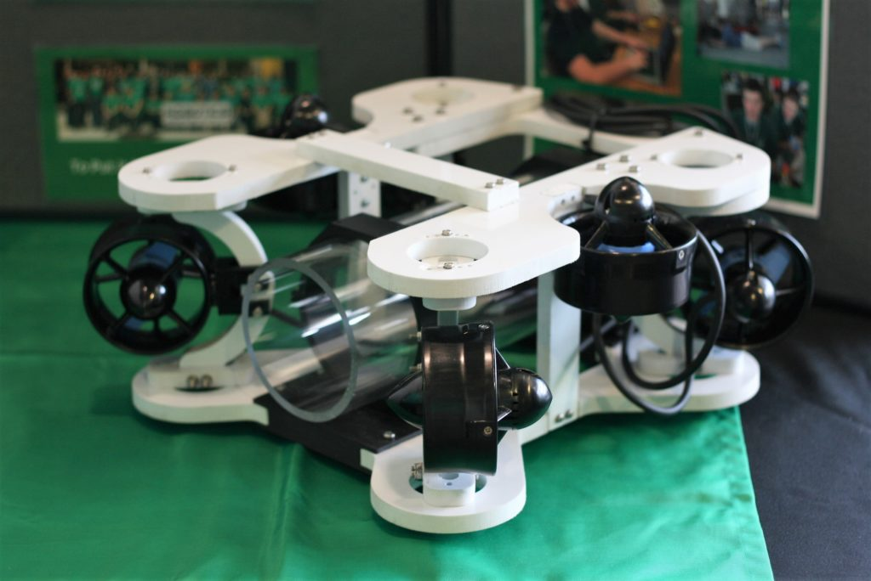

Slide 2
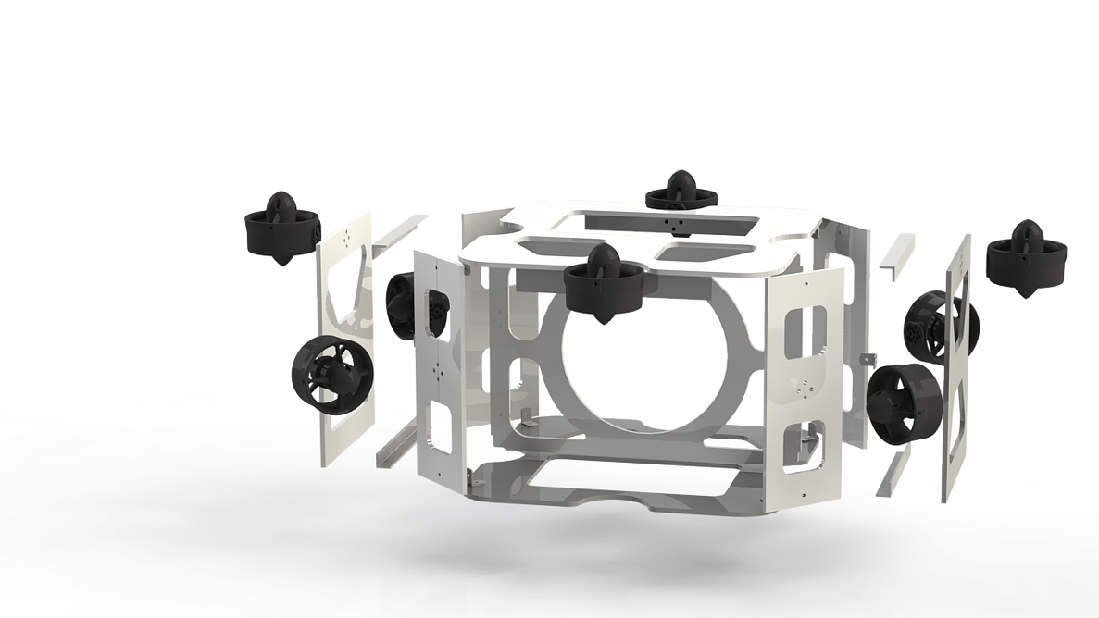
https://www.columbiaroboticsclub.com/mate-rov

Slide 3
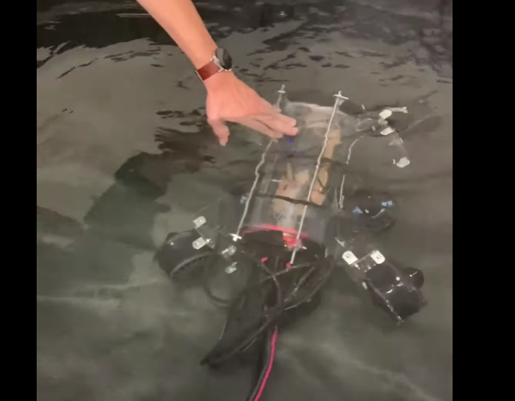

Slide 4
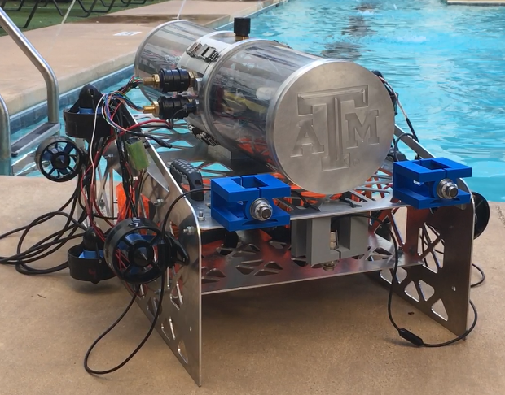

Slide 5
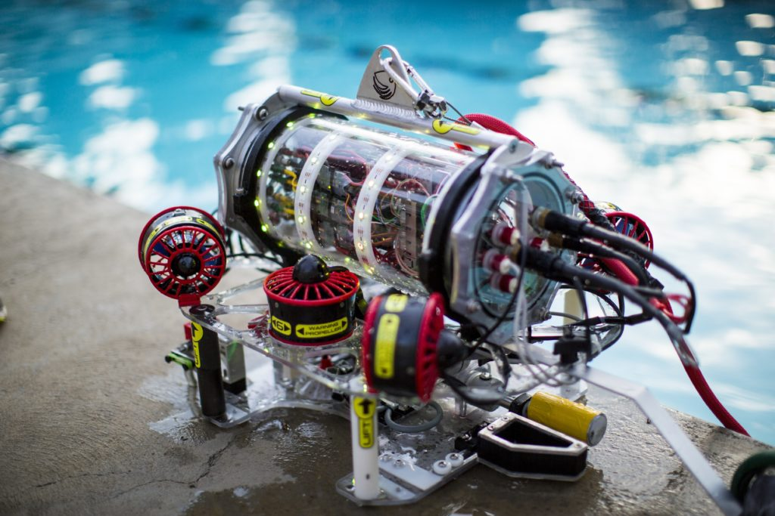

Slide 6
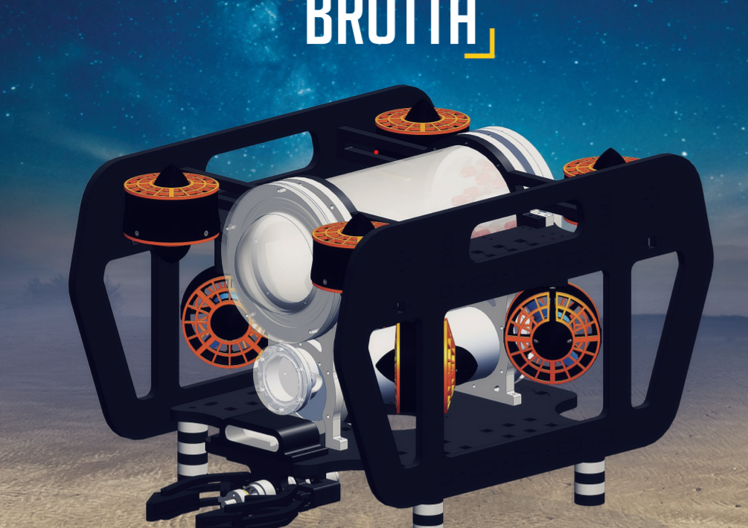
https://files.materovcompetition.org/TechReportArchives/2019/AASTMT_Invictus_Technical%20Documentation_2019.pdf

Slide 7
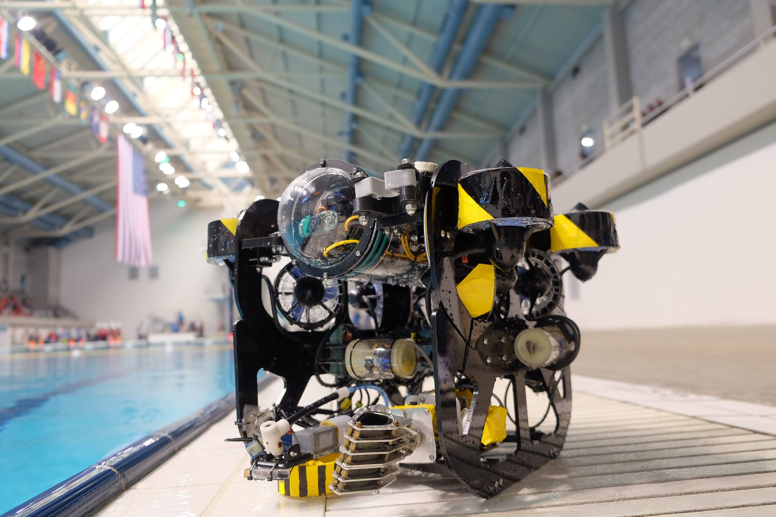
Hong Kong Polytechnic

Slide 8
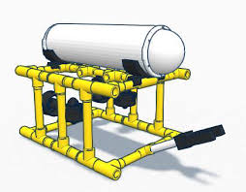
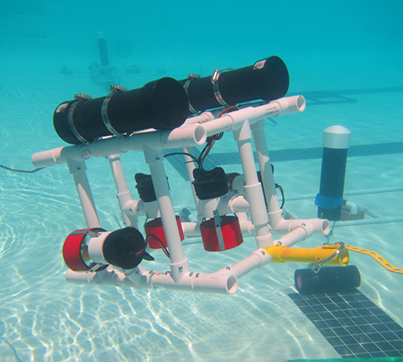

Slide 9
https://materovcompetition.org/archiveshome

